Slide 1
LEADERSHIP DEVELOPMENT CAMP AND FIELD TOUR
BATTM – 2ND AND 3RD YEAR

Slide 2
INCLUSIONS
Syllabus : Outdoor Education, Basic Wilderness First aid, Rock Craft, High Rope courses, Team Building Exercises, Energizers, Survival skills, Expedition planning, Method of river crossing, compass orientation, Trekking, Rafting.
Competitions: Best trainee and best rope.
ORGANISED BY:
HIMALYAN VAGABOND ADVENTURES

Slide 3
PART 1: BASIC TRAINING AT THE CAMP
Day 1:
6: 00 AM: Fall in
6:15 – 7:30 AM: Morning Exercise/running/ yoga
8:00 – 8:45 AM: Breakfast
9:00 – 1:00 PM: Outdoor Education session; equipment introduction, rope knots and tent pitching
1:30 – 2:30 PM: Lunch
3:00 – 5:00 PM: Method of river crossing
5:30 PM: Tea Break
6:00 – 7:00 PM: lecture on wilderness first aid
7:00 - 8:00 PM: Your own time
8:00 – 8:45 PM: Dinner
9:00 – 9:50 PM: Reflection session on LDC
10: 00 PM: Into tents
10:30 PM: Lights off

Slide 4
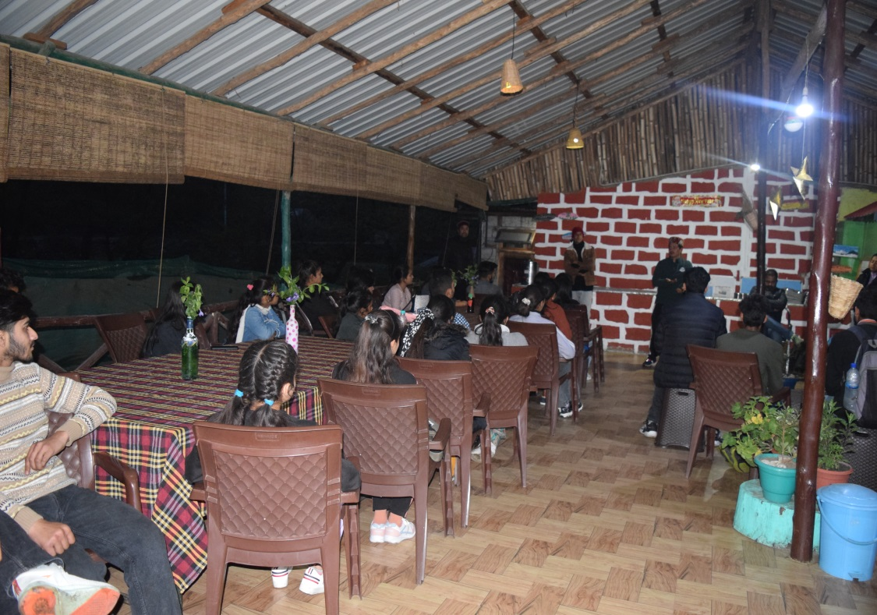
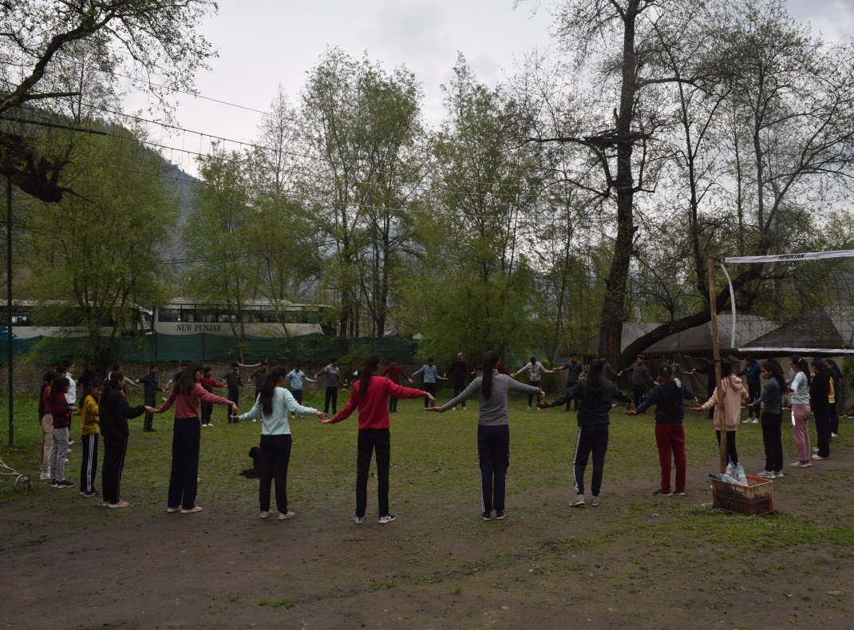
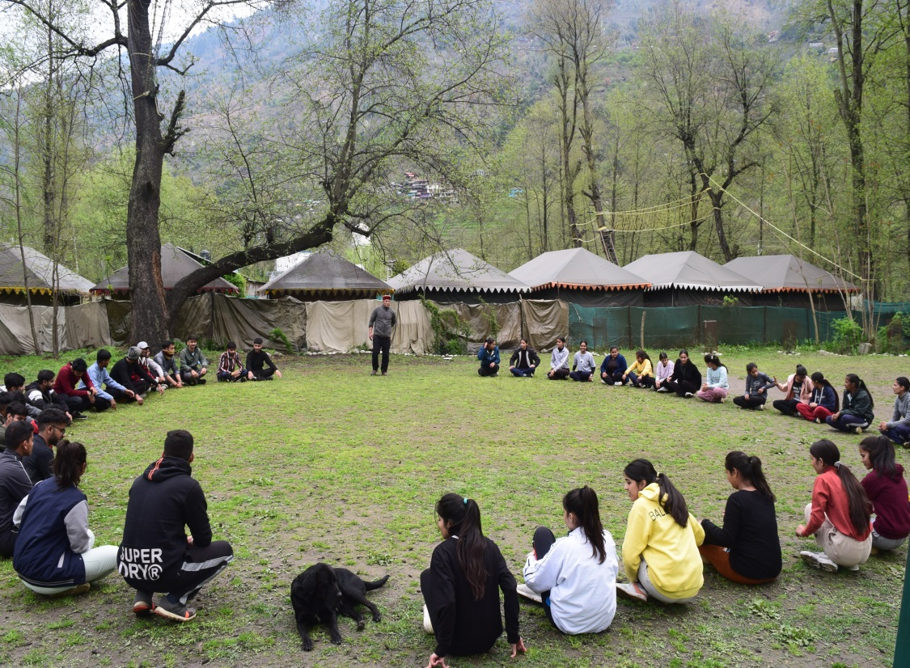
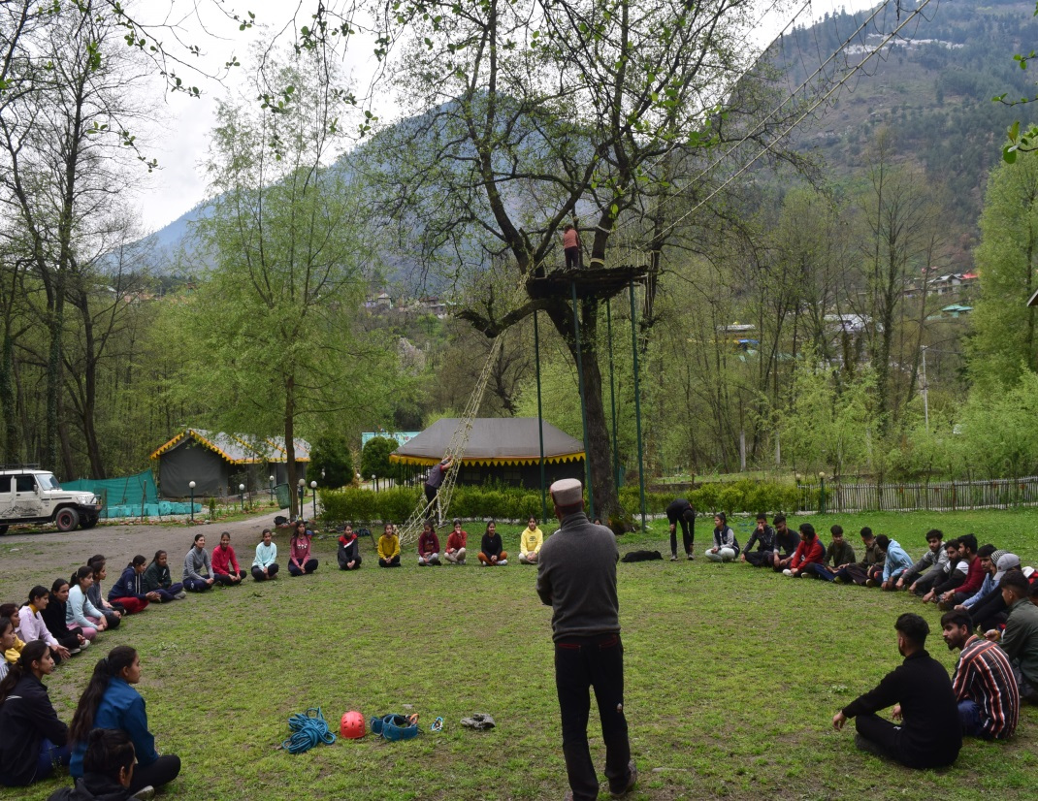

Slide 5
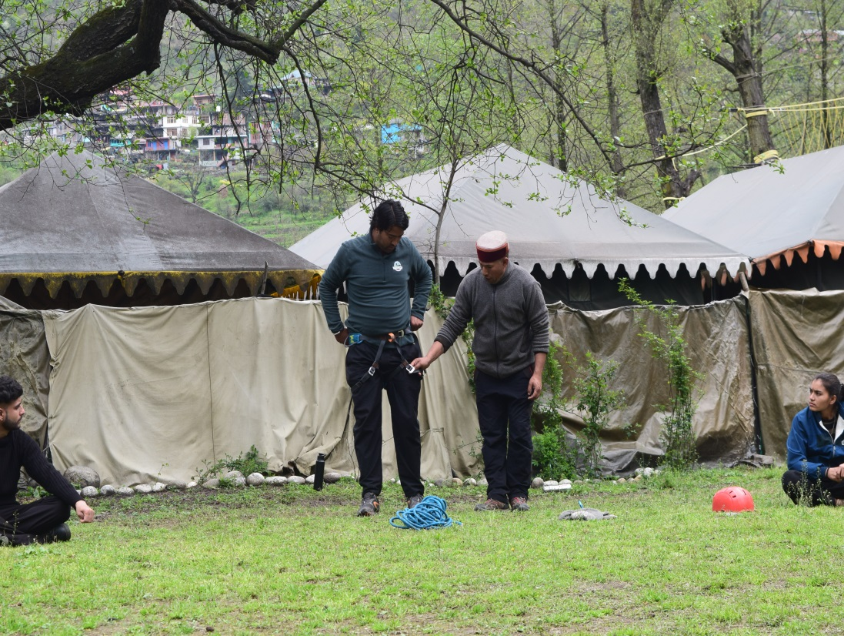
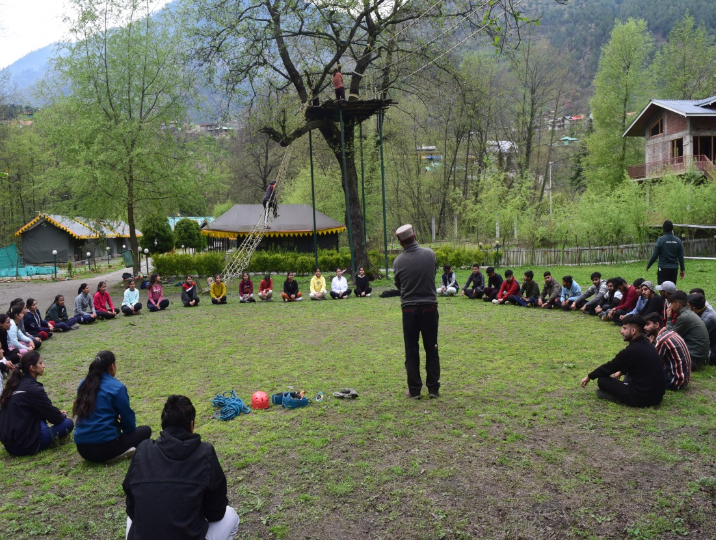
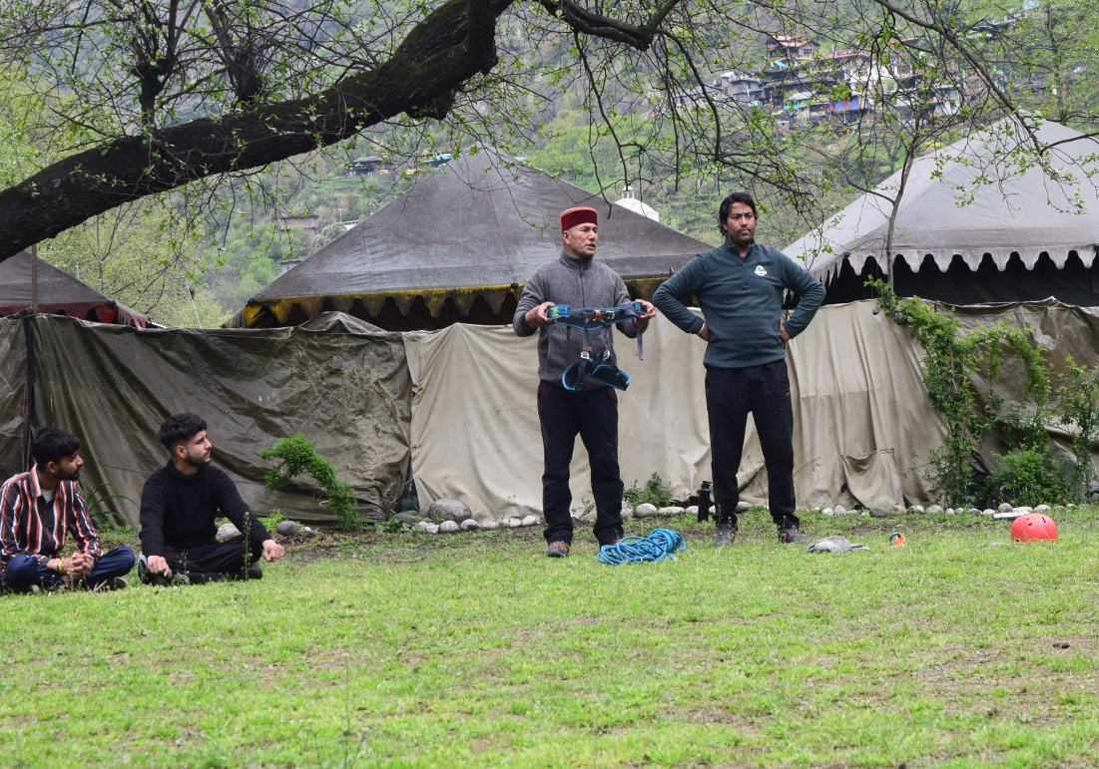
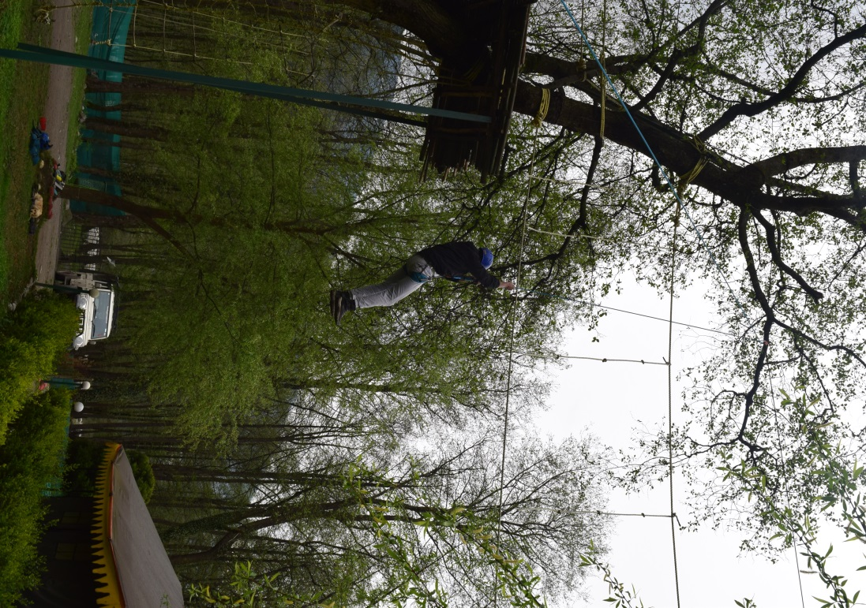

Slide 6
Day 2:
6: 00 AM: Fall in
6:15 – 7:30 AM: Morning Exercise/running/ yoga
8:00 – 8:45 AM: Breakfast
9:00 – 1:00 PM: Rock Craft: Lecture on Anchor and belay, Learn techniques of rock climbing
and rappelling
1:30 – 2:30 PM: Lunch
3:00 – 5:00 PM: lecture on compass orientation followed by wilderness compass orientation
which we call LDC CHALLENGER!!
5:30 PM: Tea Break
6:00 – 7:00 PM: RUMBLE SESSION to open up and overcome to the hesitation
7:00 - 8:00 PM: Your own time
8:00 – 8:45 PM: Dinner
9:00 – 9:50 PM: Reflection session
10: 00 PM: Into tents
10:30 PM: Lights off

Slide 7
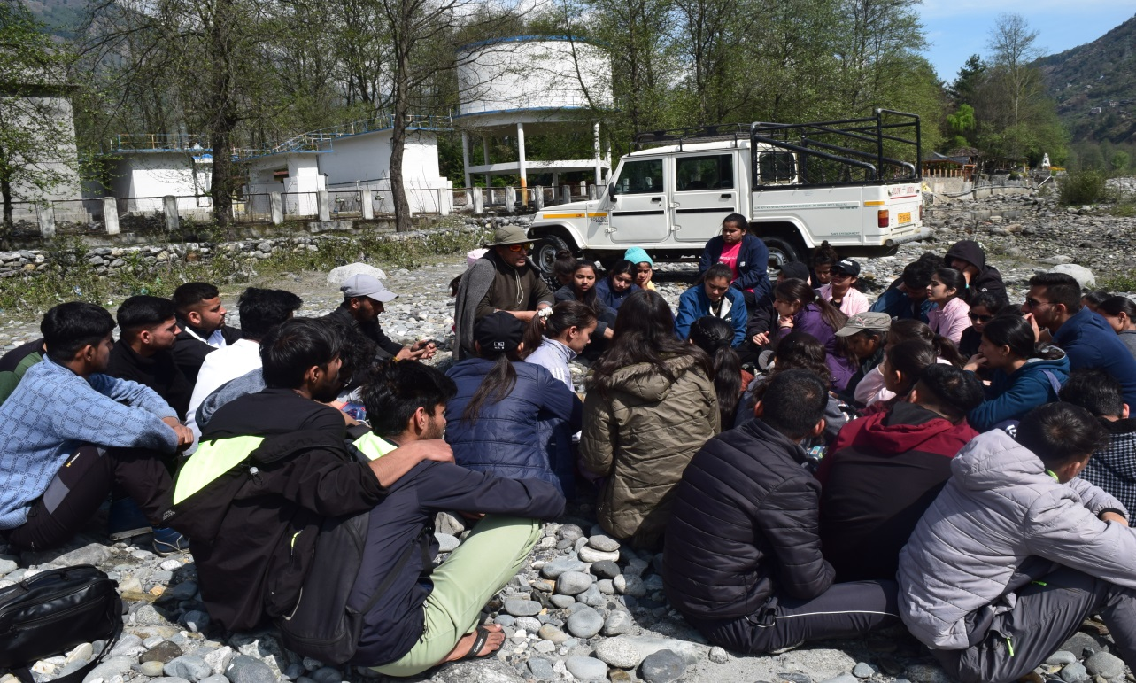
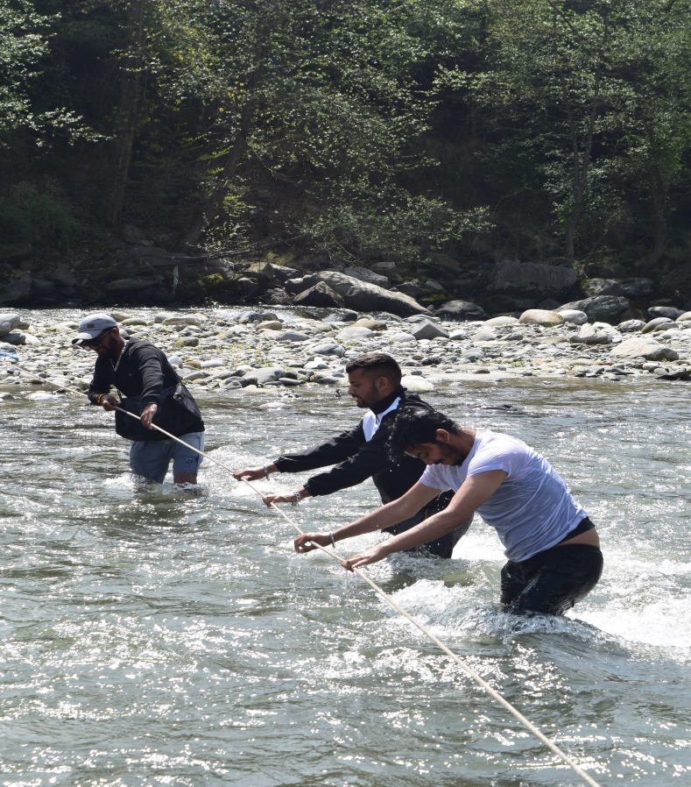
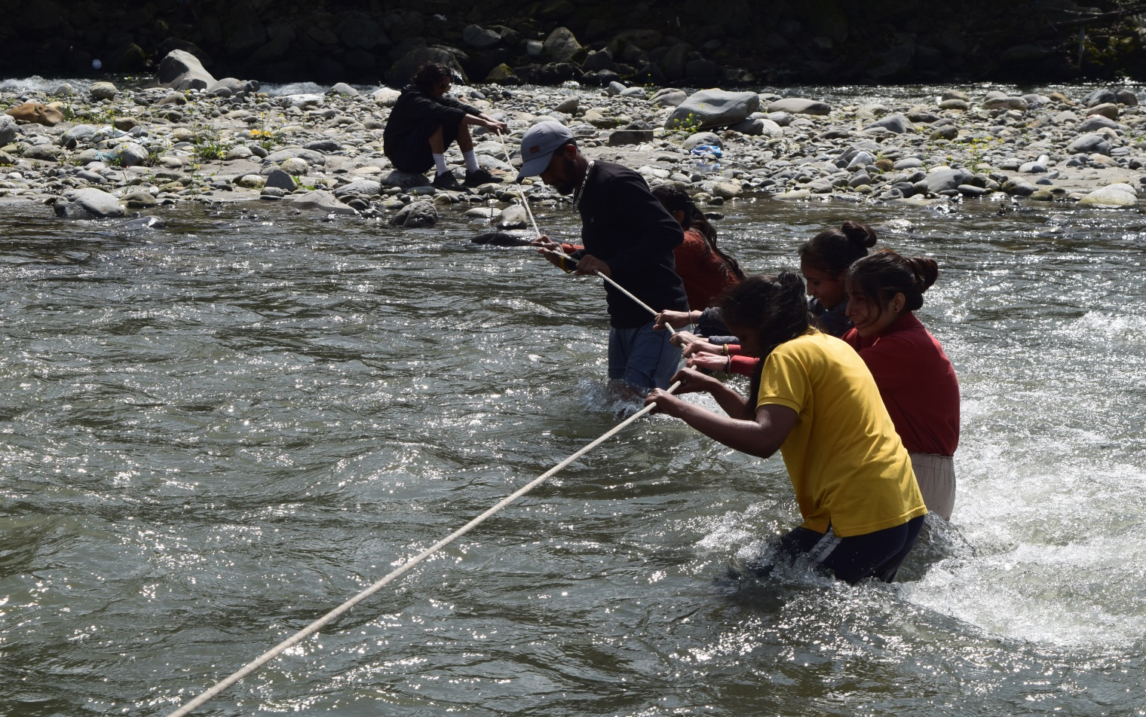

Slide 8
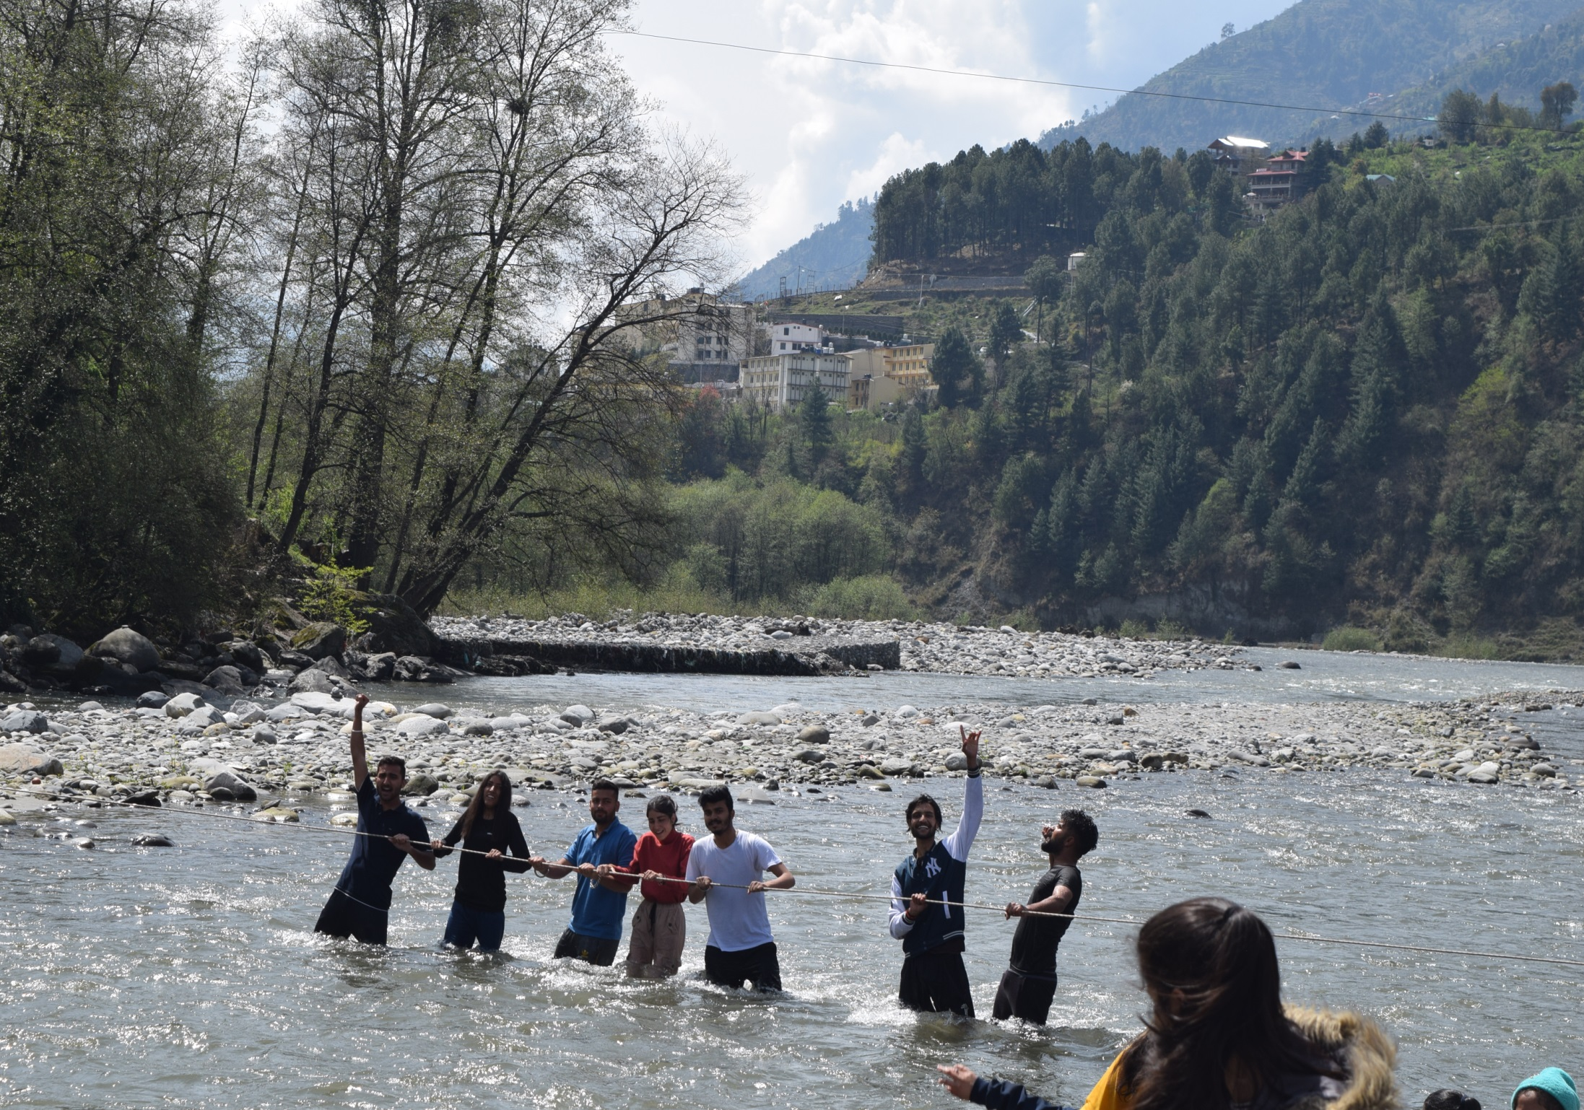

Slide 9
Day 3:
6: 00 AM: Fall in
6:15 – 7:30 AM: Morning Exercise/running/ yoga
8:00 – 8:45 AM: Breakfast
9:00 – 1:00 PM: HIGH ROPE COURSES: Friendship Ladder, Sloth walk, Burma Bridge and
Commando net climbing
1:30 – 2:30 PM: Lunch
3:00 – 5:00 PM: Session on Management and leadership skills through Team Building
Exercises
5:30 PM: Tea Break
6:00 – 8:00 PM: Lecture on Mountain Manner, LNT, Survival and Expedition Planning
8:00 – 8:45 PM: Dinner
9:00 – 9:50 PM: preparation and planning for expedition
10: 00 PM: Into tents
10:30 PM: Lights off

Slide 10
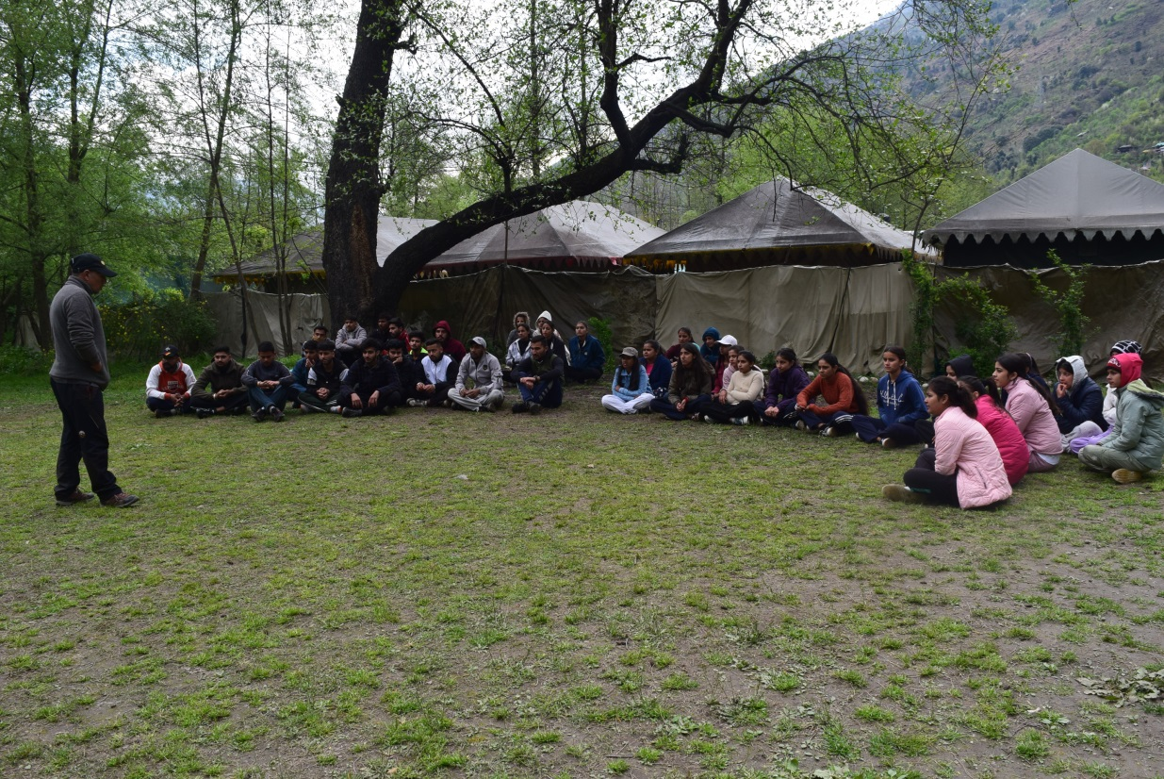
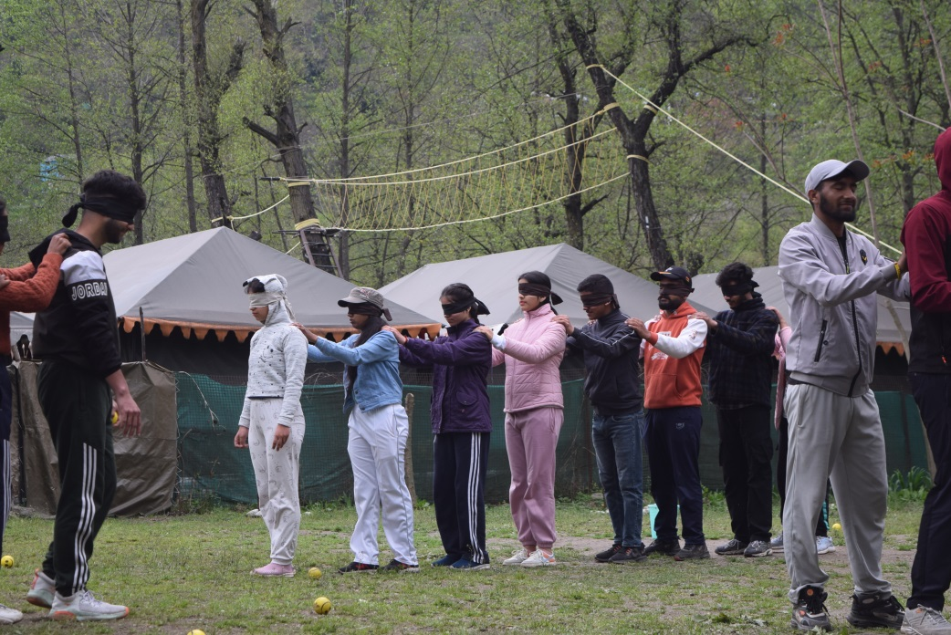
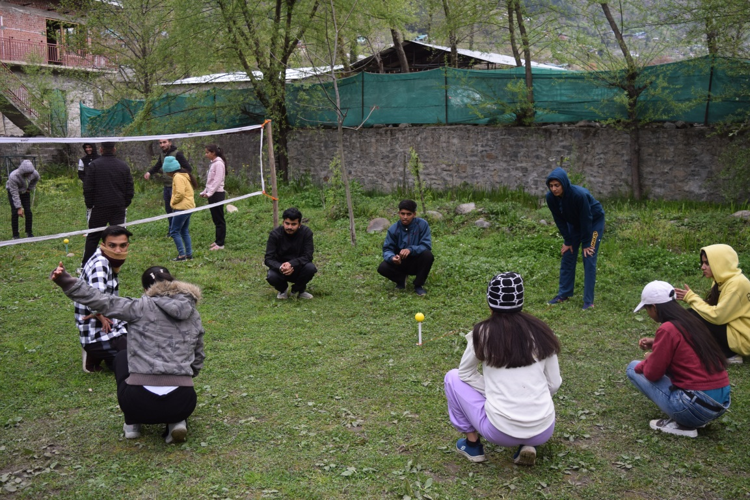
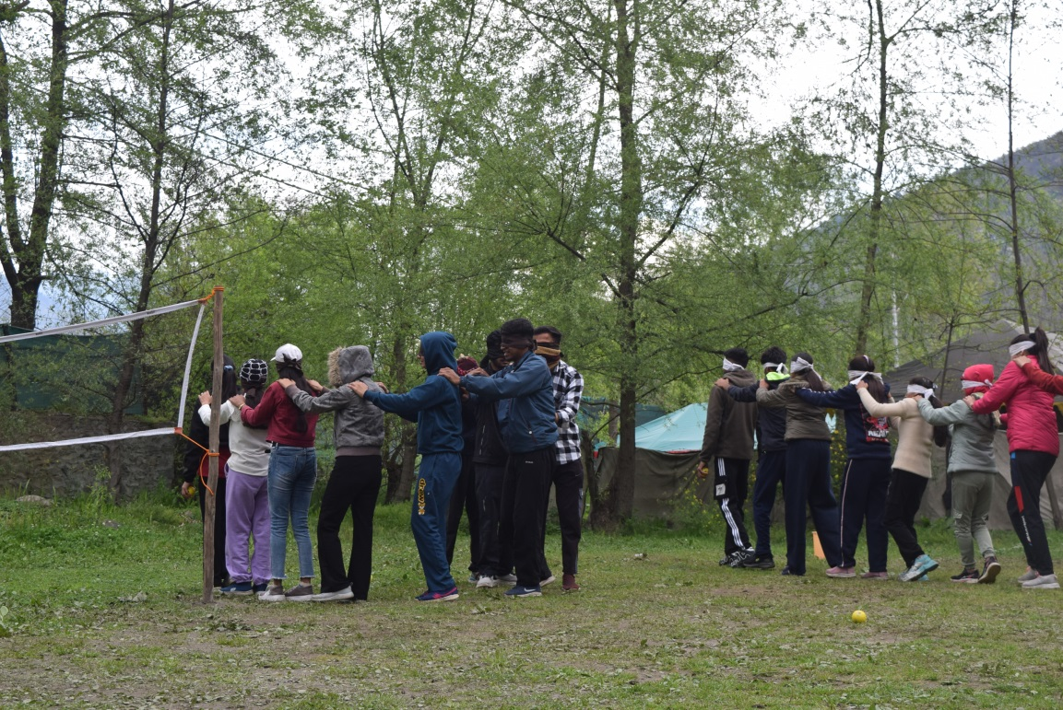

Slide 11
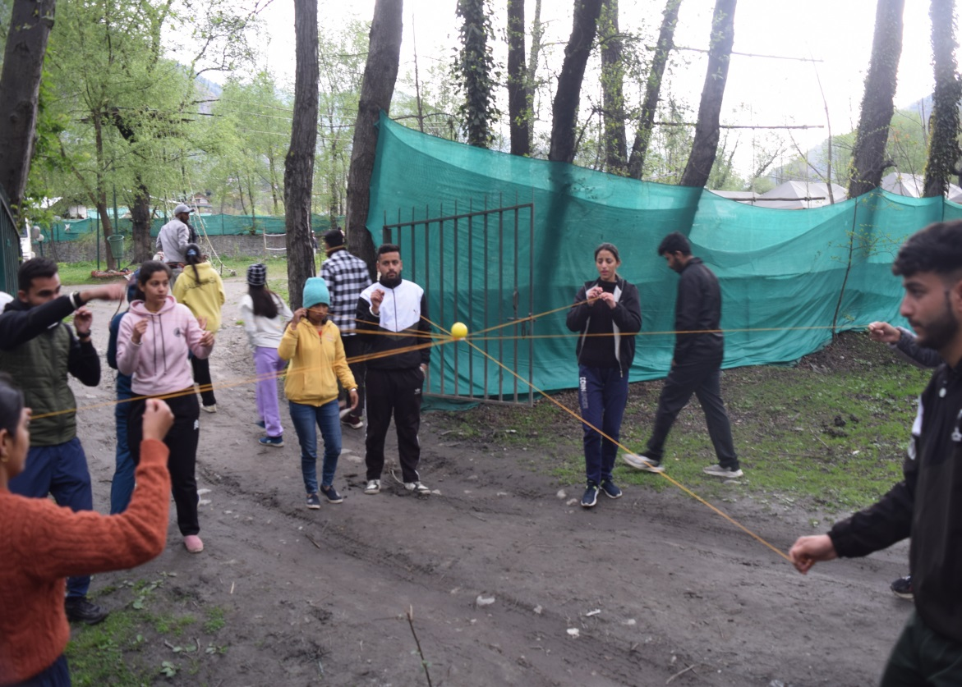
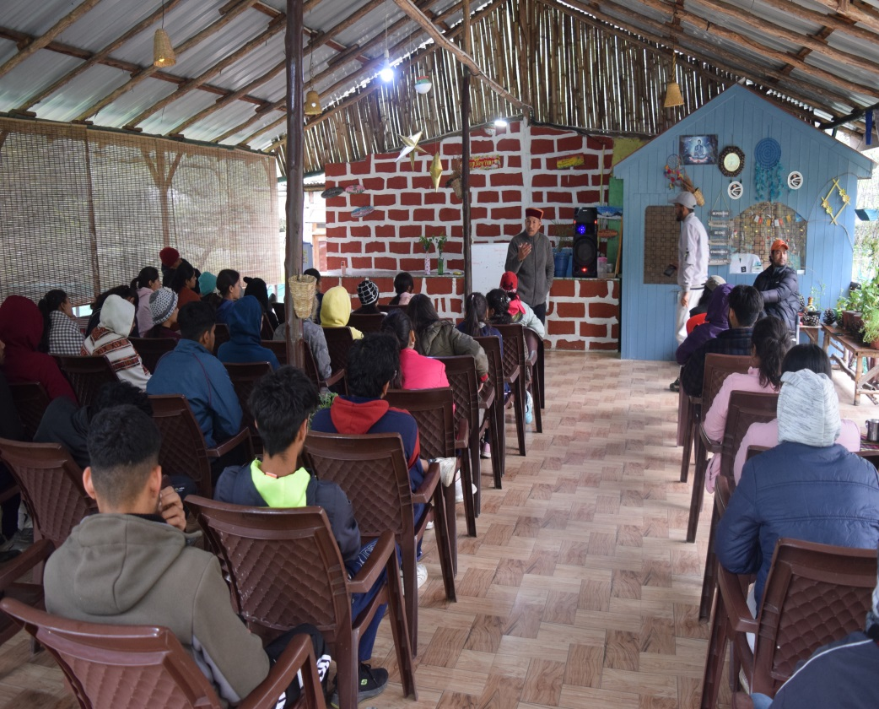
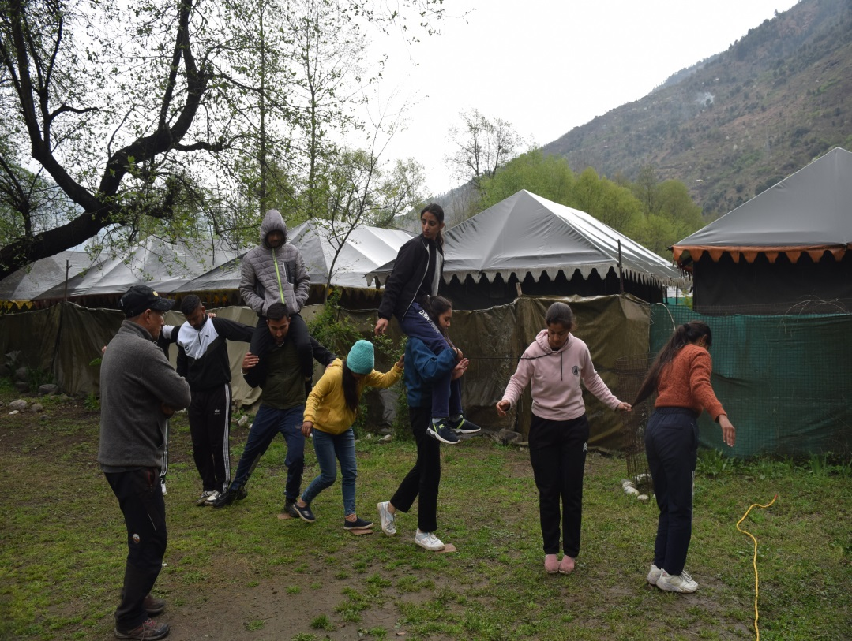
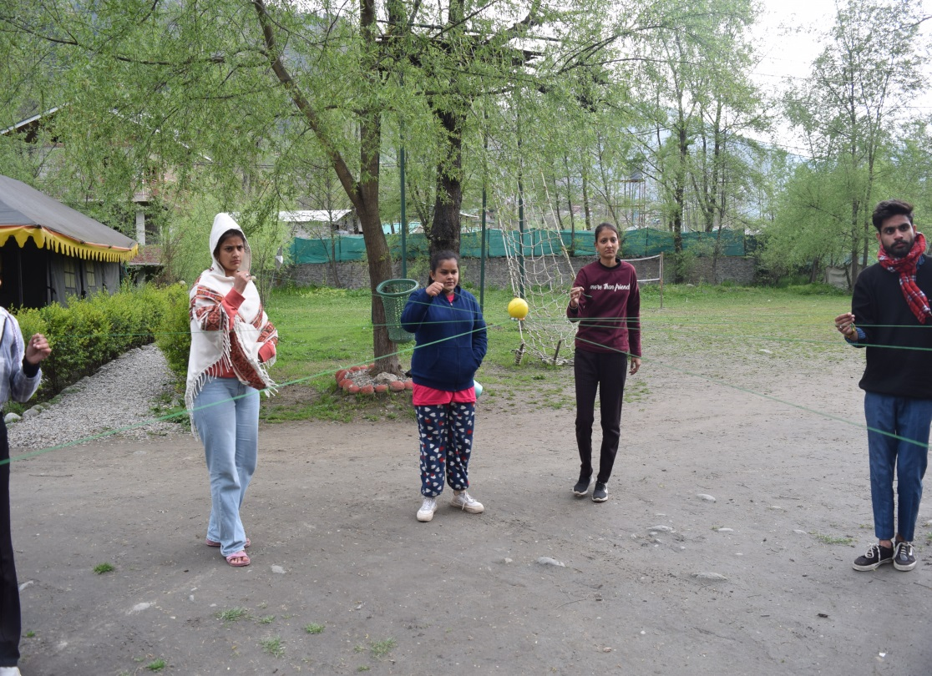

Slide 12
PART 2: EXPEDITION AND SURVIVAL BEGINS!!
Day 4: Trekking - HVA Camp – Gadani - Kufri
After the safety briefing we start the trek from the camp. Today is going to be an easy and gradual trek. We trek through the local villages and some Apple, Plum, Pear Orchards. As we start to incline, view of the Manali valley starts to evolve. The trail also takes us through the shady pine forest. We will take a halt at Gadani Village, have refreshment break at Birnath Temple premises. After an hour’s rest we resume the trek, from here the trail takes us through the dense pine forest. We reach in beautiful meadow of Kufri within the couple of hours.
Picnic lunch at Kufri. Thereafter we trek back to Mahili Bihal for the survival camp. Here we set our own tent and do bit of a fire wood collection. Students will try their hands on cooking in the jungle.
Dinner & overnight stay in Alpine tents.

Slide 13
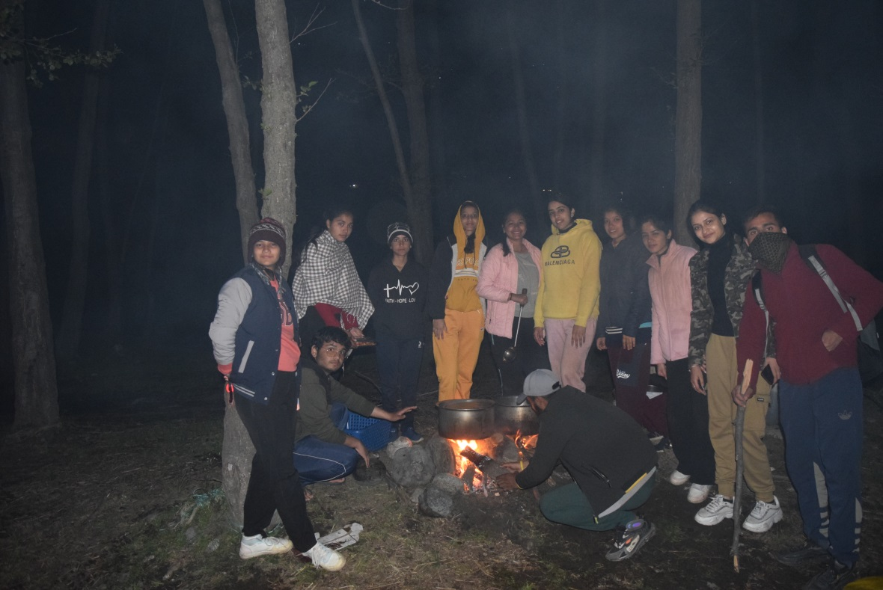
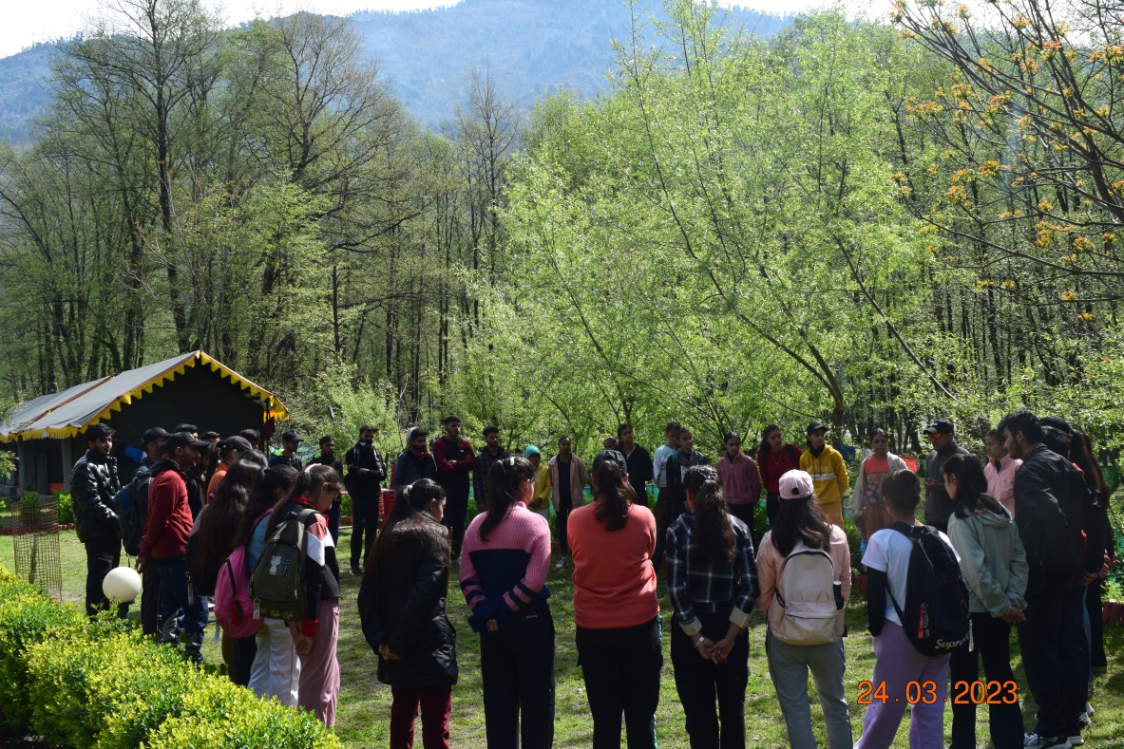
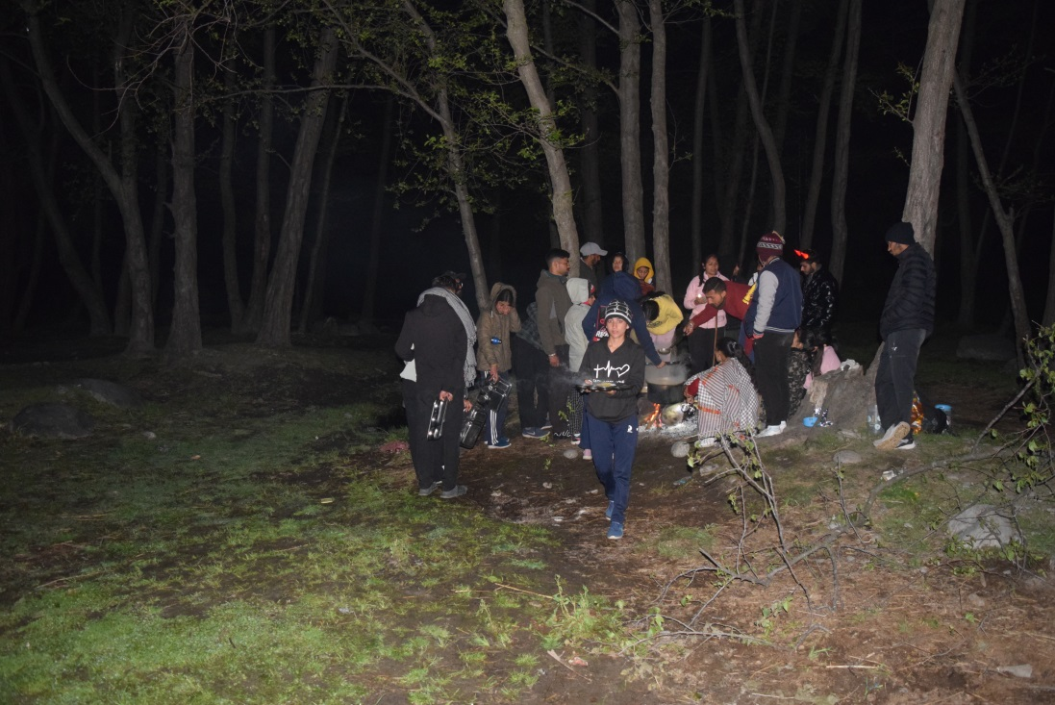
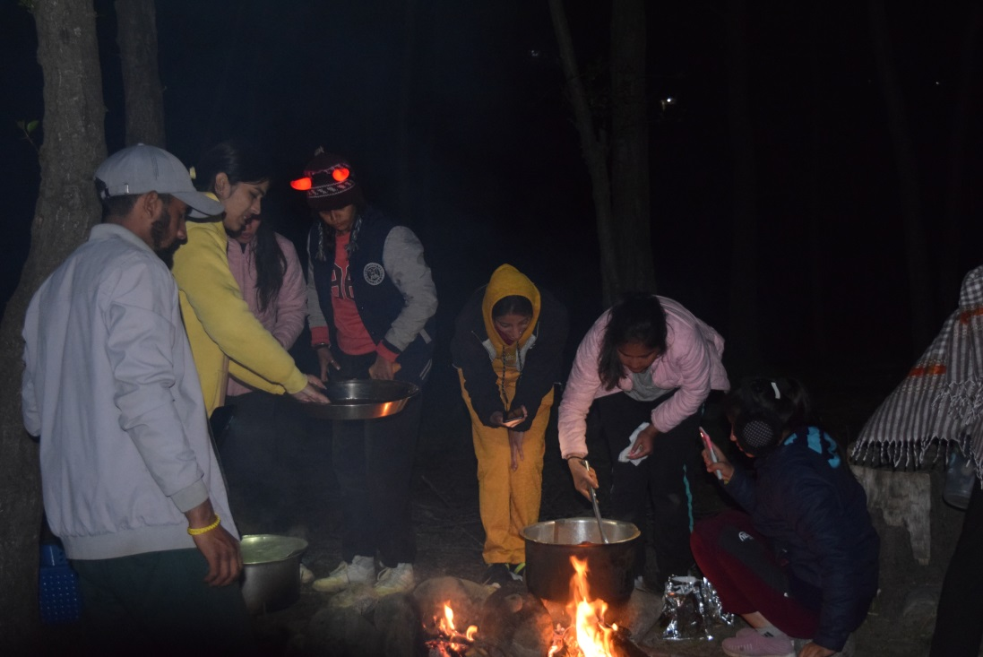

Slide 14
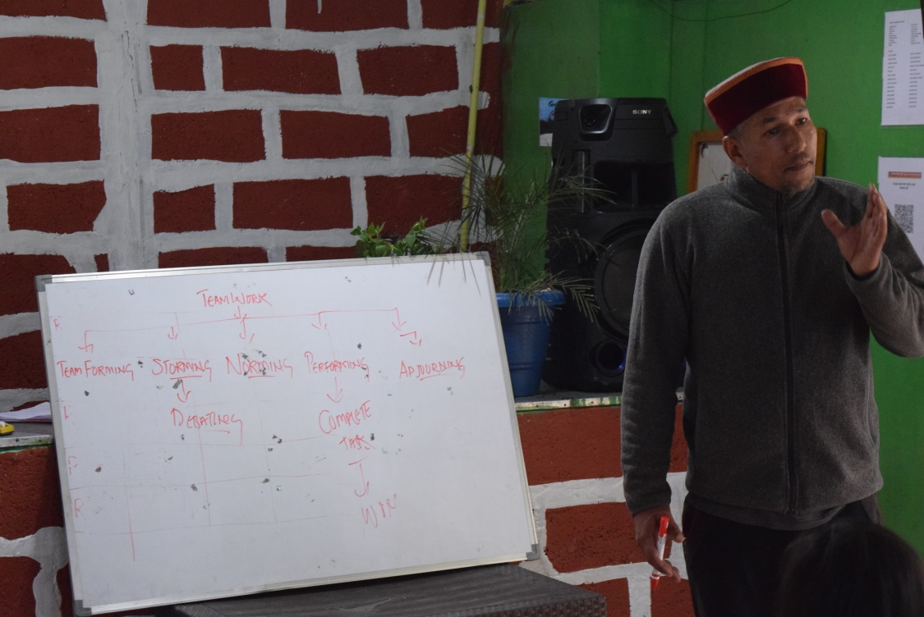
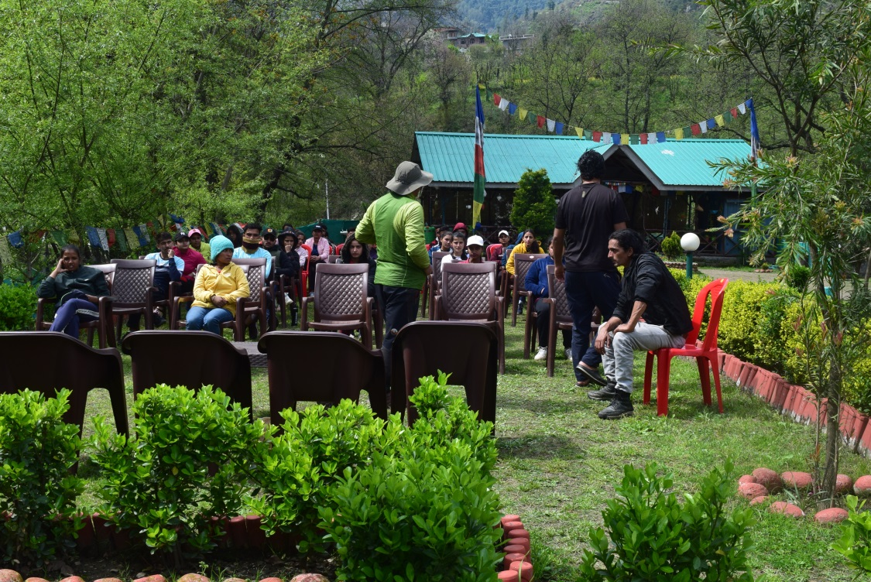
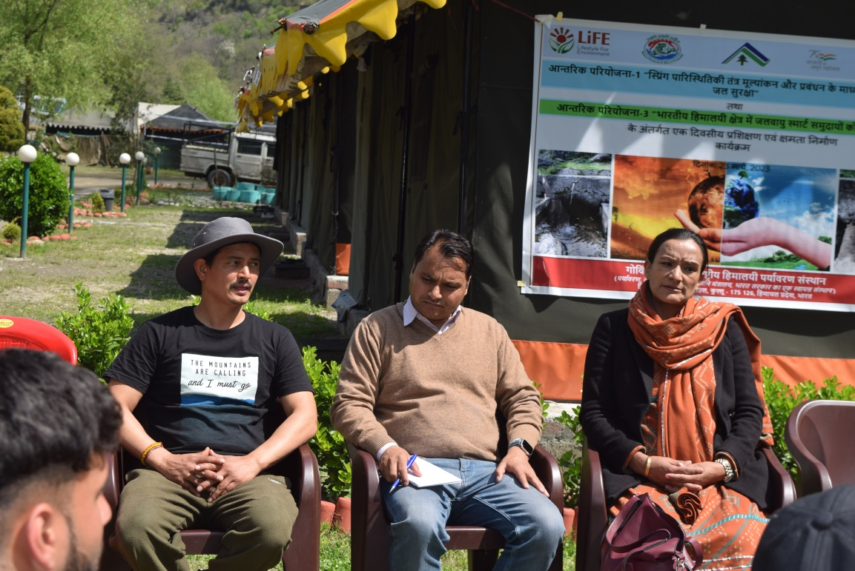
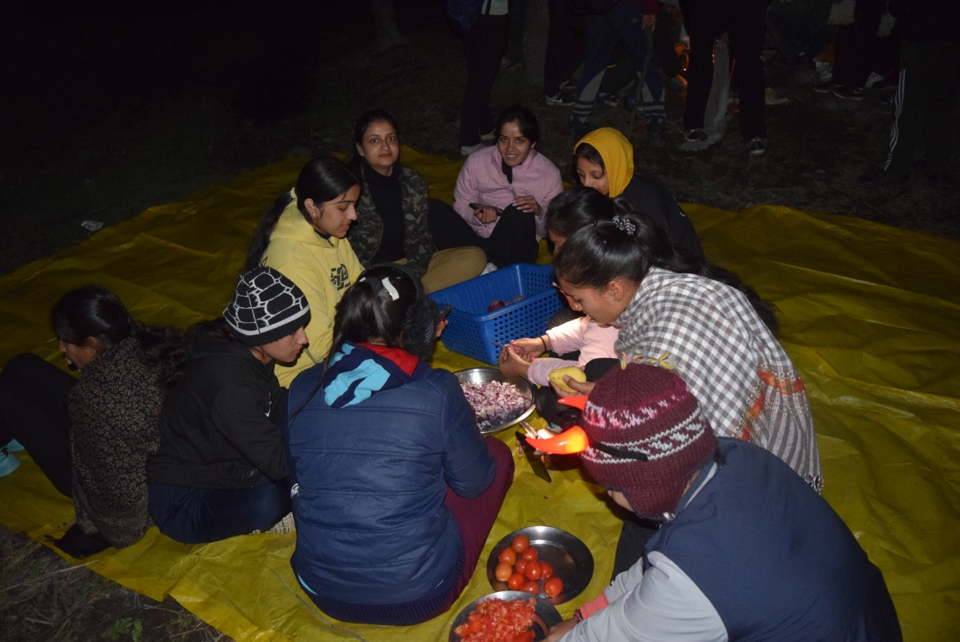

Slide 15
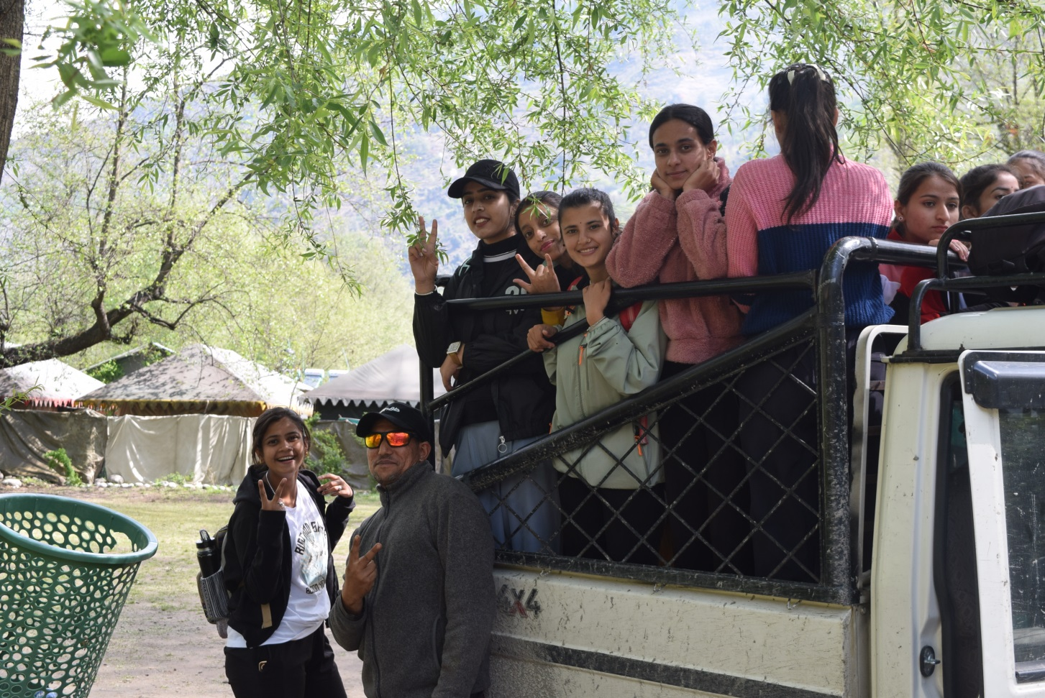
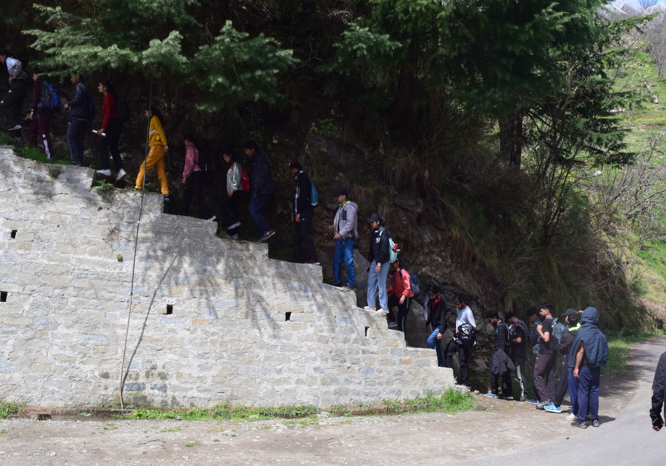
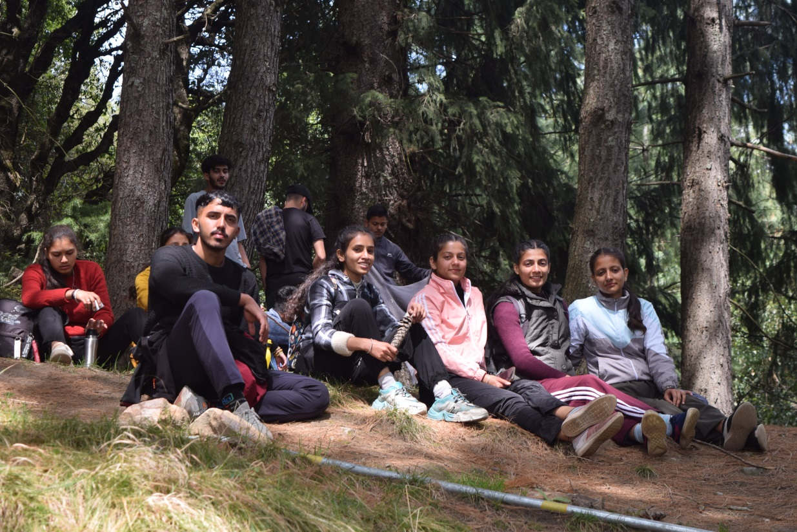
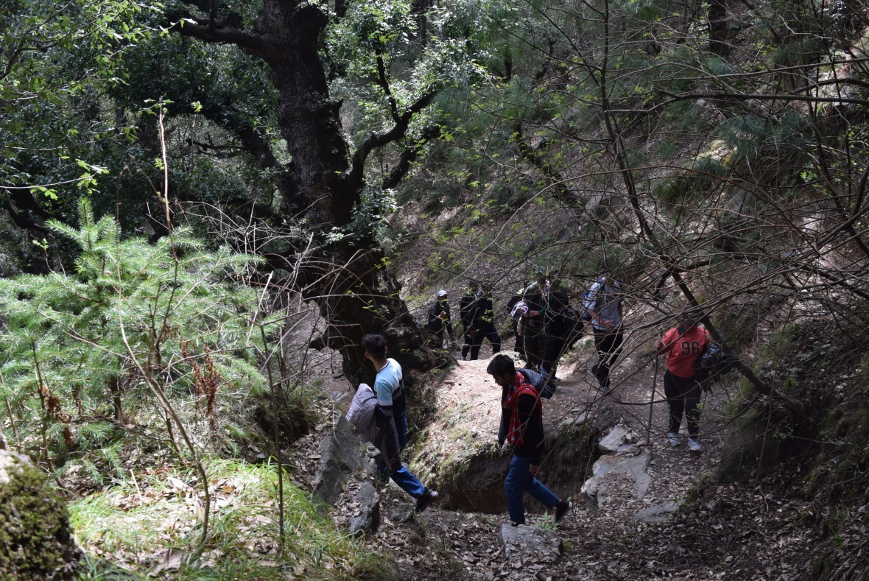

Slide 16
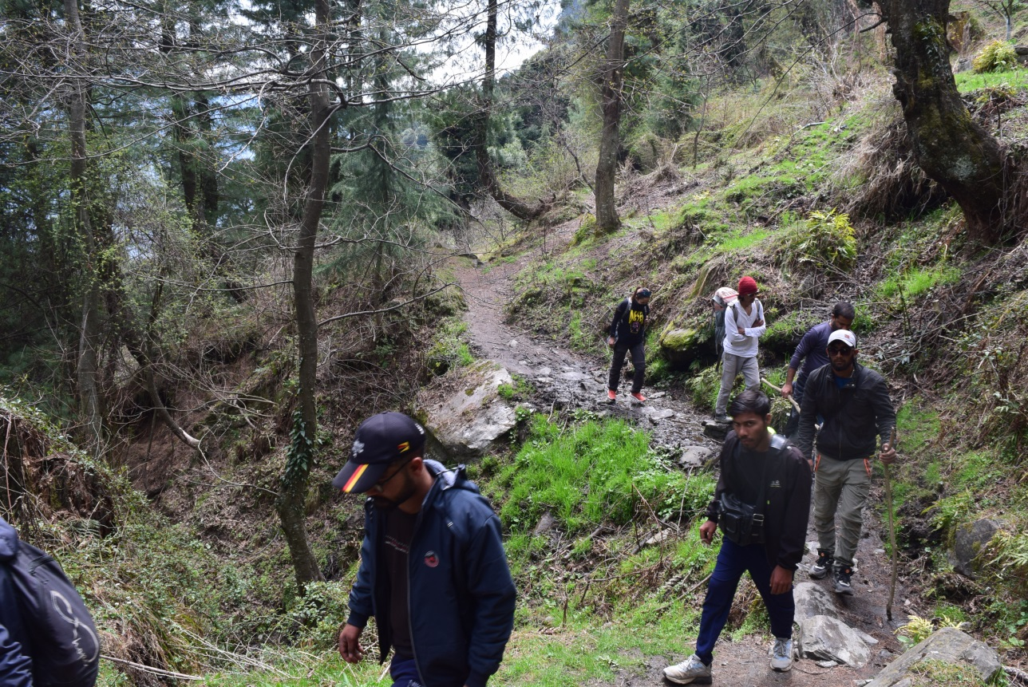
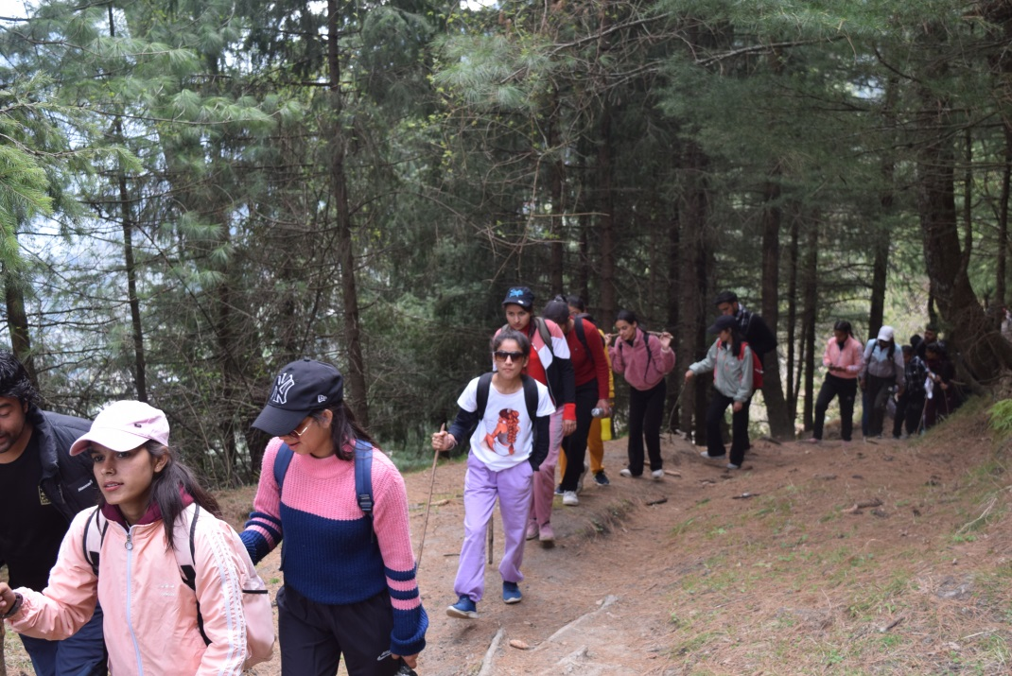
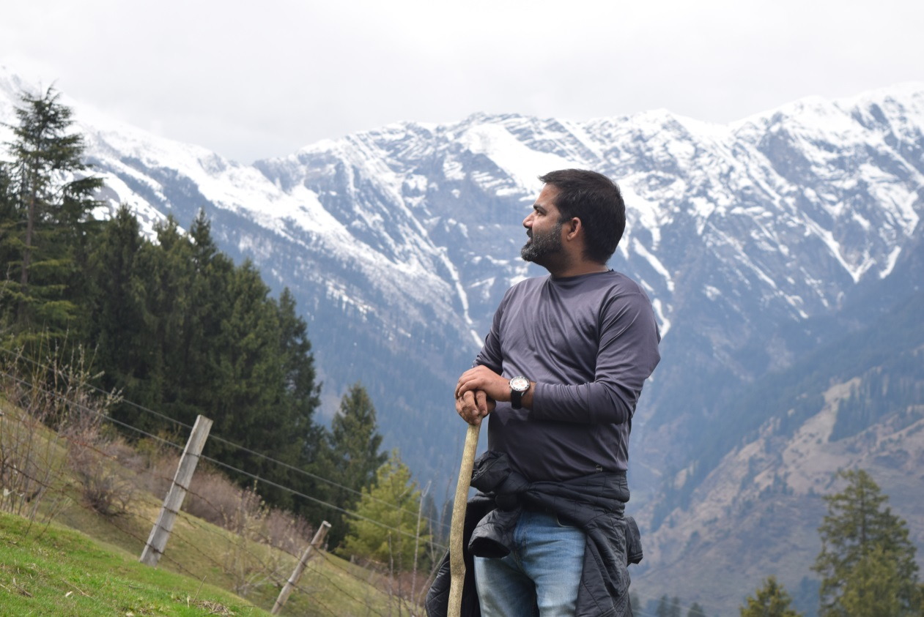
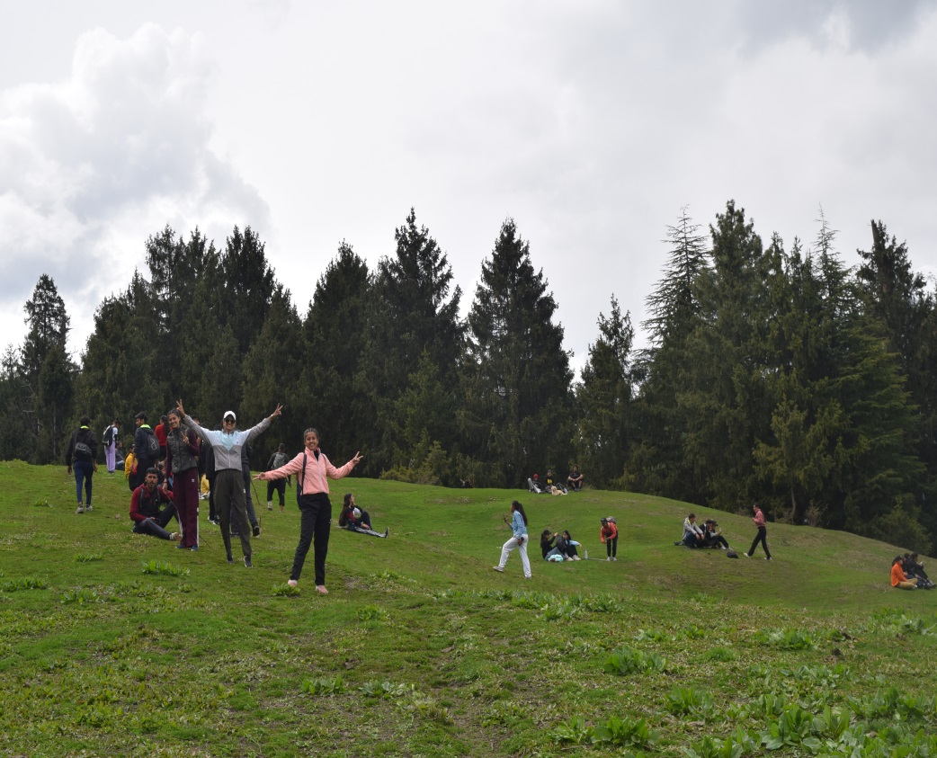

Slide 17
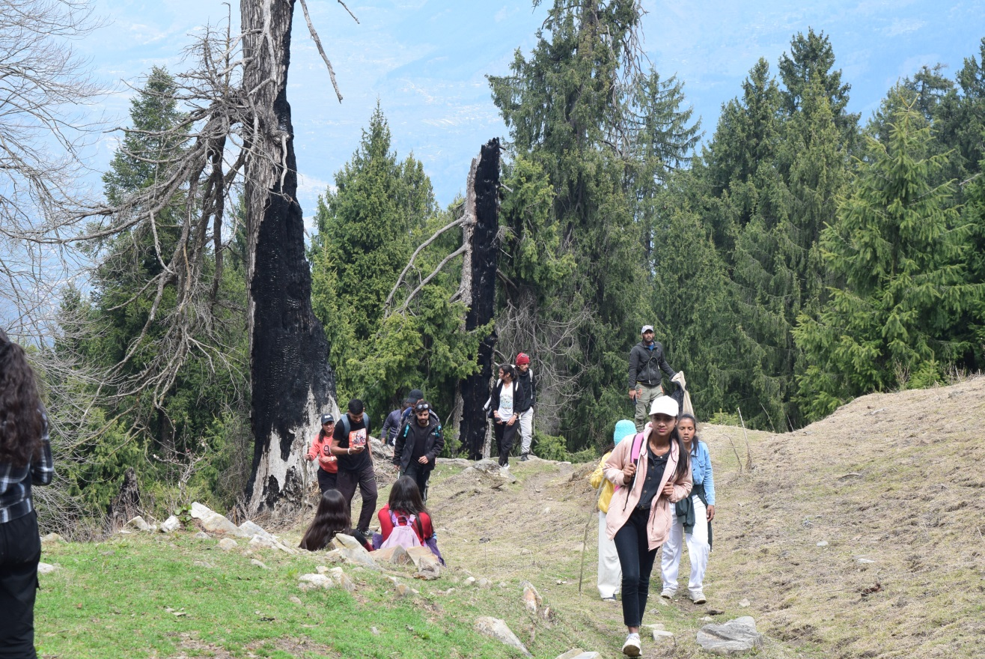
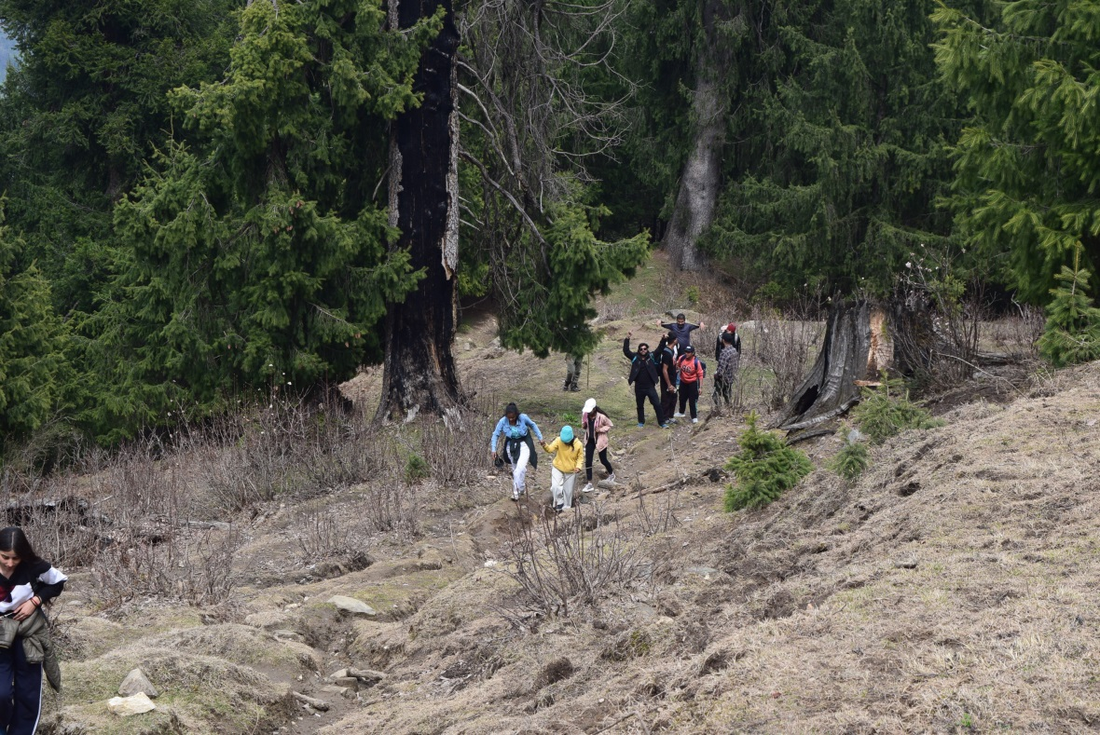
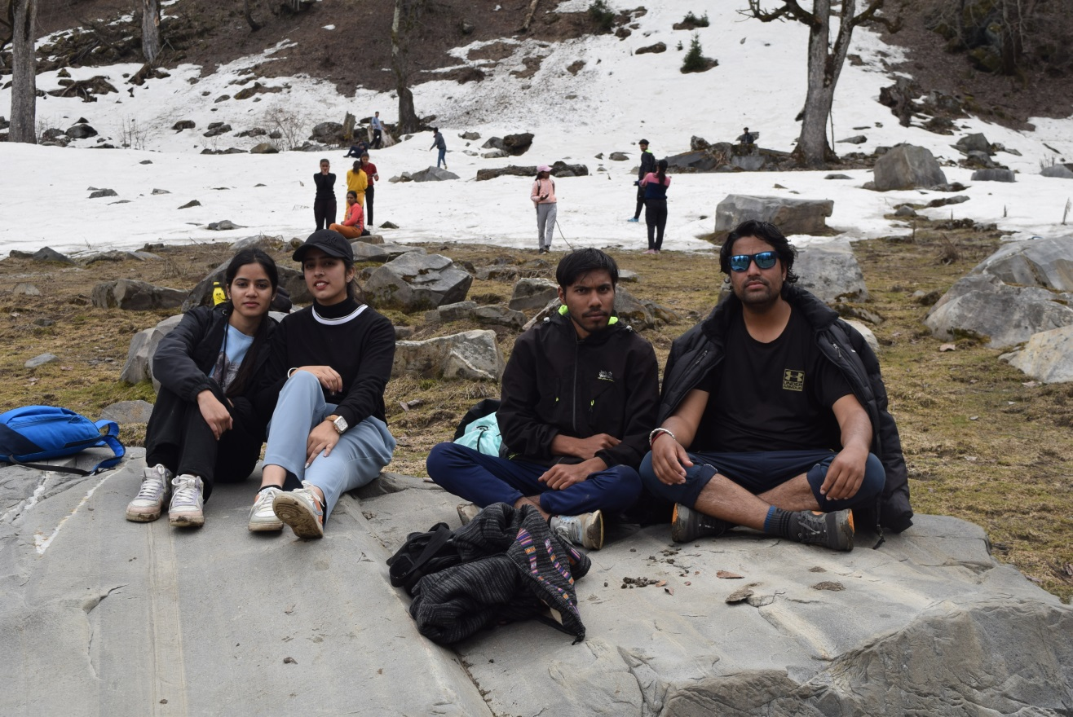
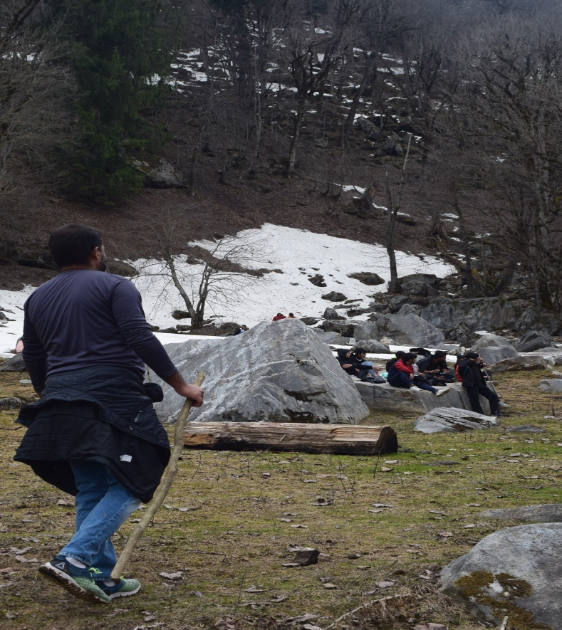

Slide 18
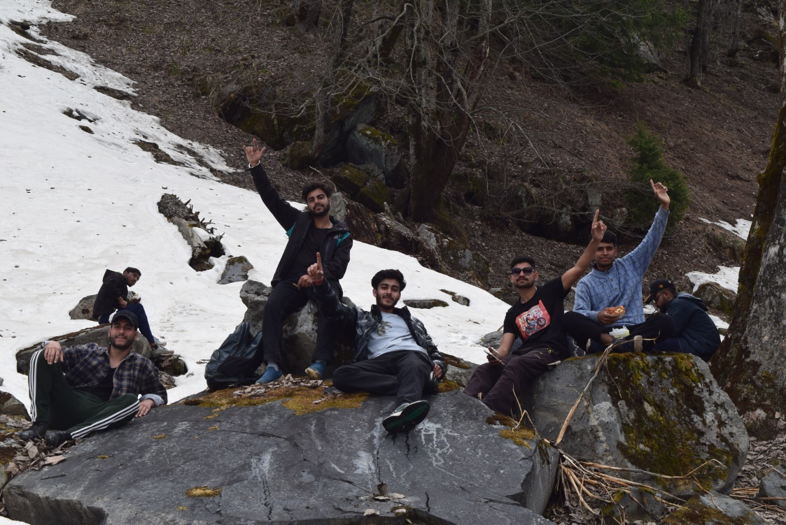
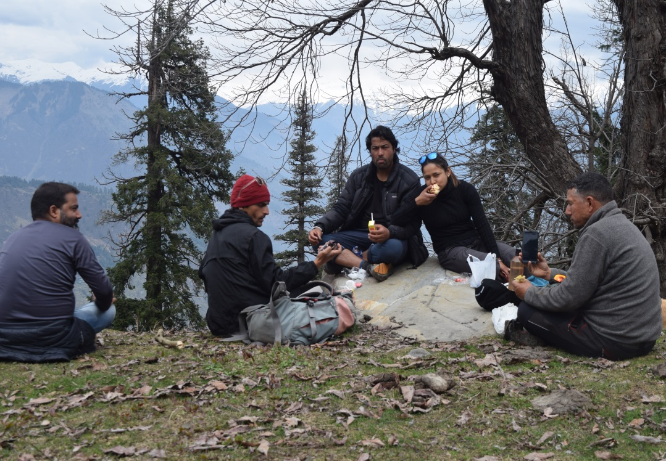
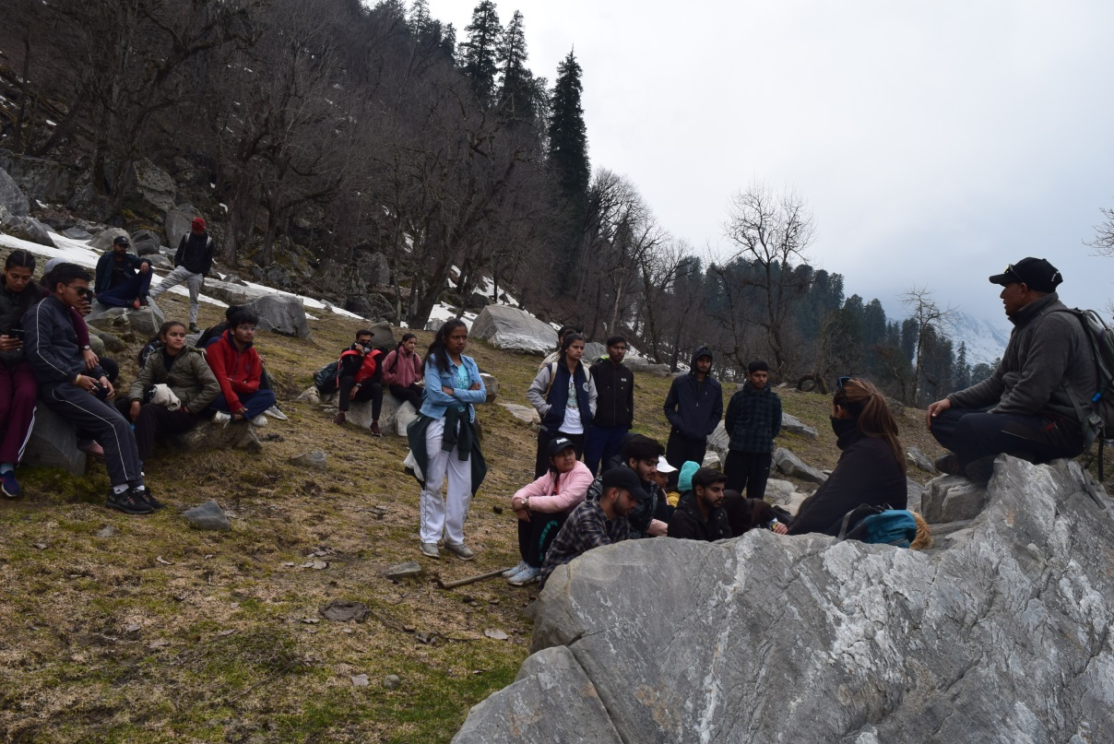
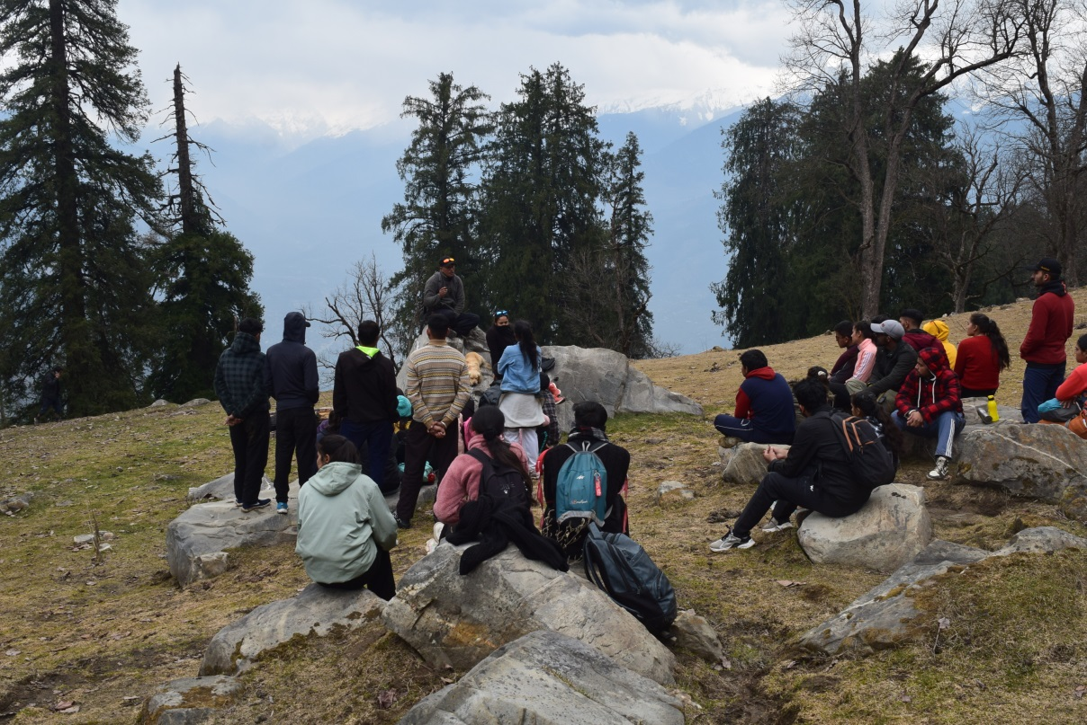

Slide 19
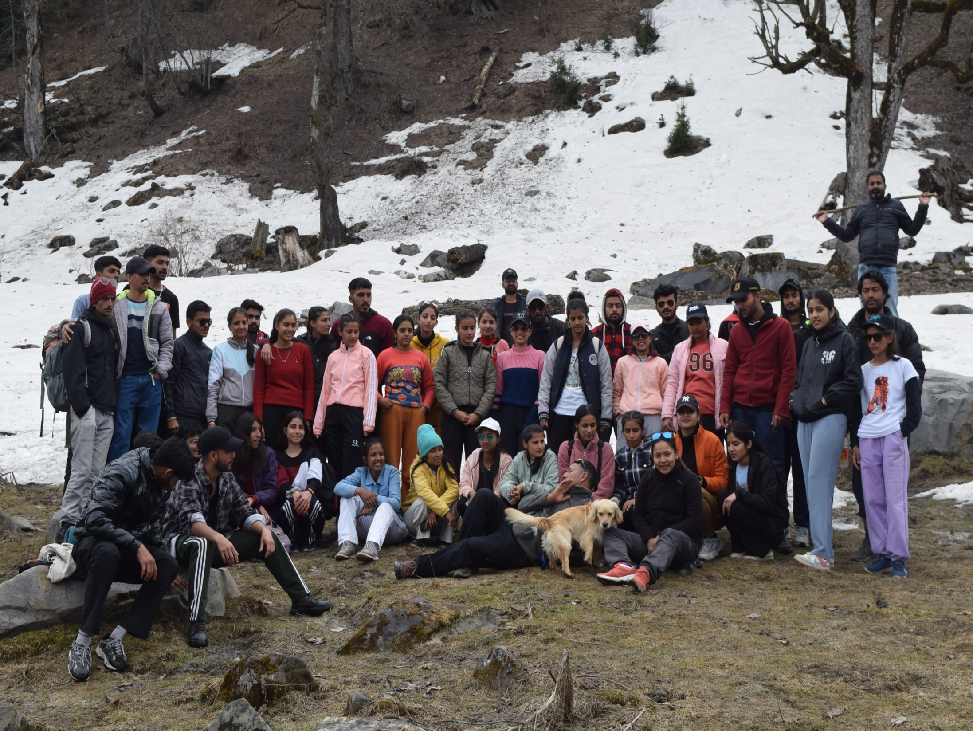

Slide 20
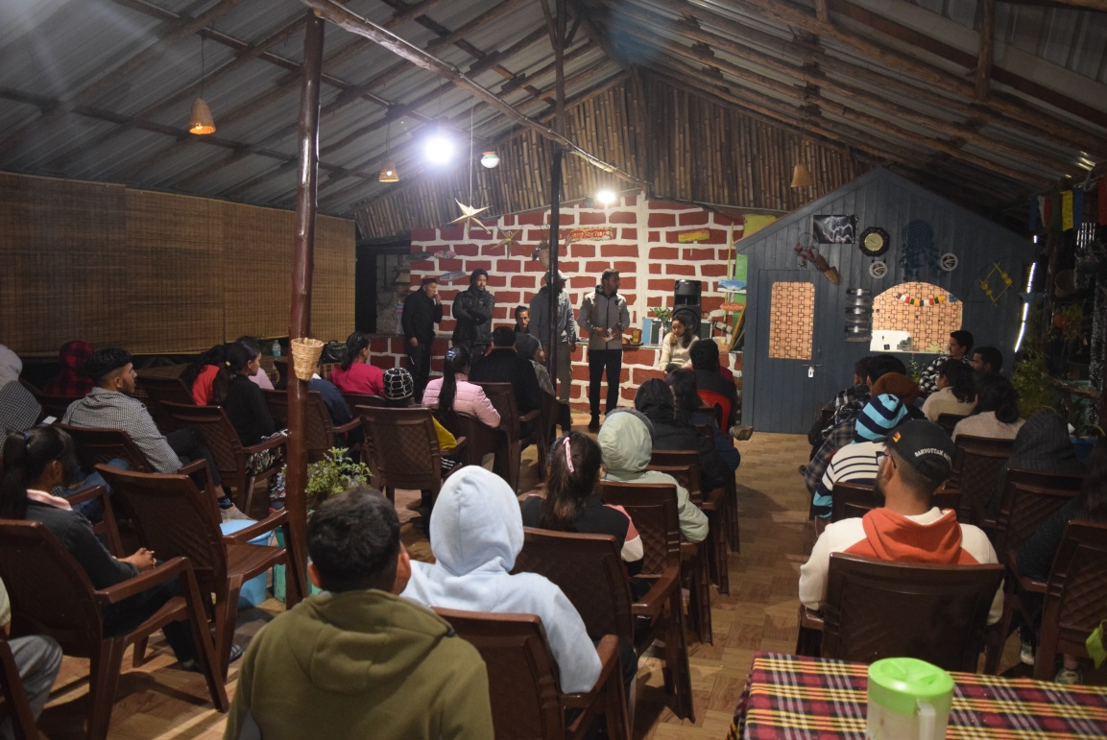
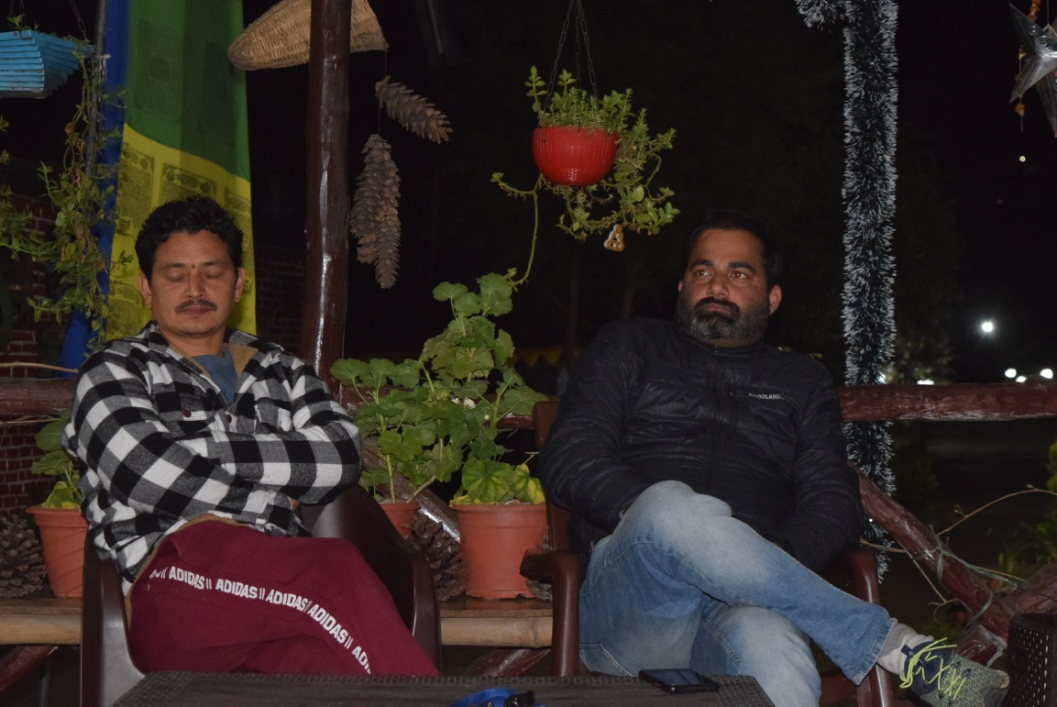
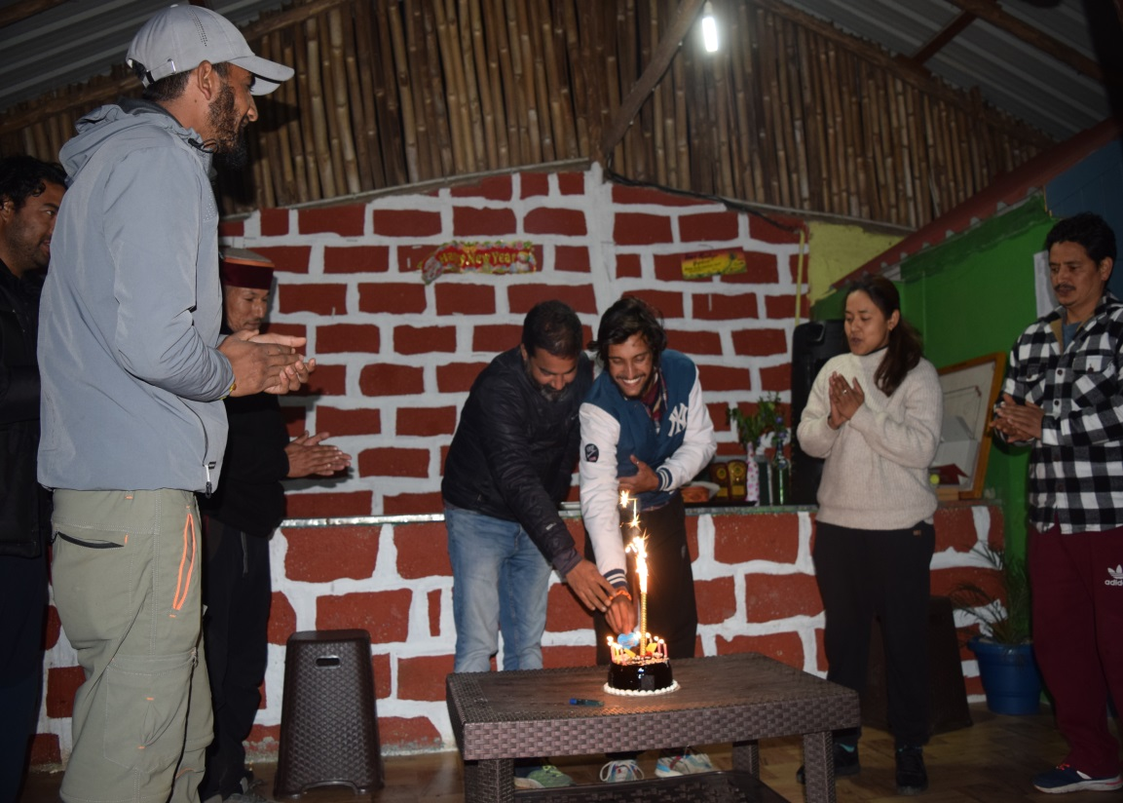
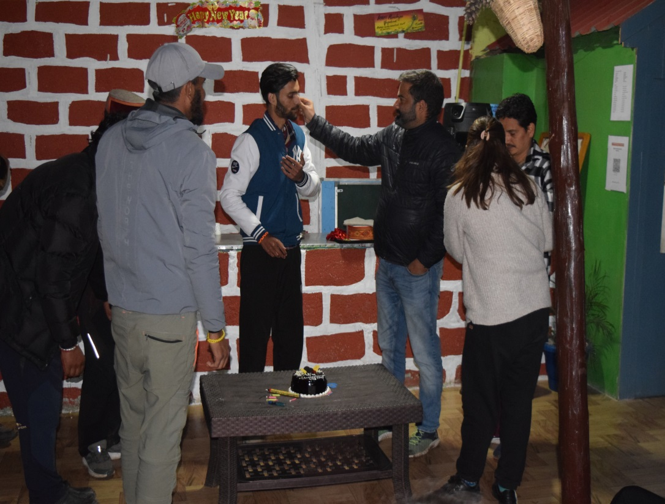

Slide 21
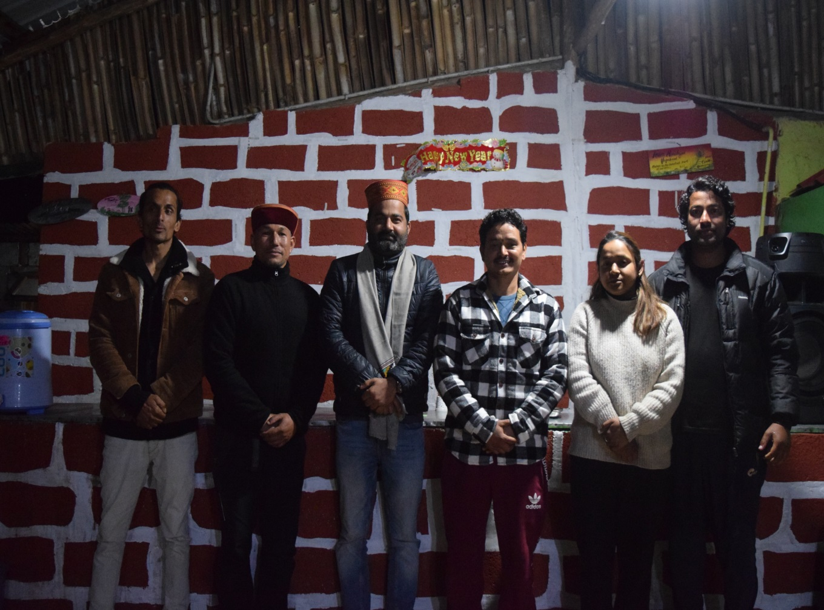

Slide 23
THANK YOU

