Slide 1
NETAJI SHUBHASH CHANDER BOSE MEMORIAL
GOVT. COLLEGE HAMIRPUR (ANU)
Inter college Judo (Men/Women) Championship
A REPORT
G.C Rajgarh organised Men and Women Judo championship on 28-29th November 2024.
Total 27 colleges took part and competition start according to the weight categories. Our college bagged 1st Runner up trophy in Men’s section and 2nd Runner up trophy in Women’s section.

Slide 2
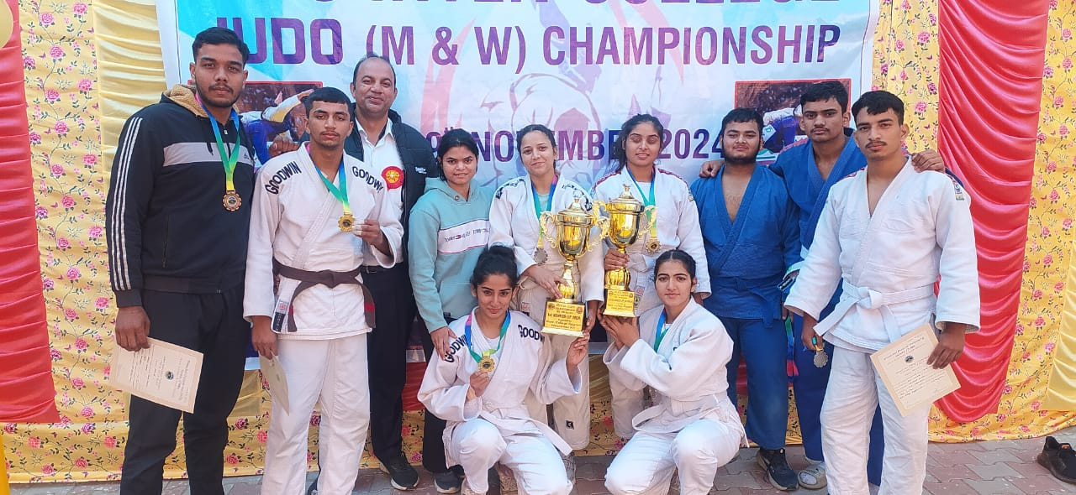
HONORING ACHIEVERS

Slide 3
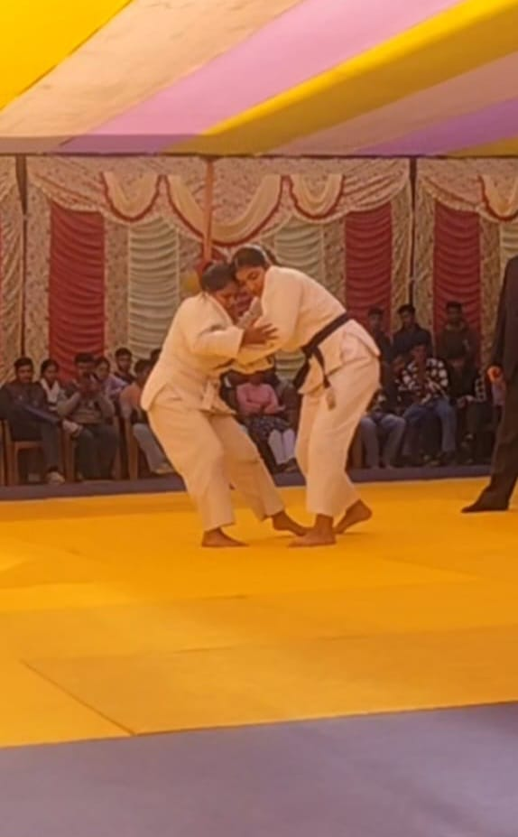
RESULT(MEN)
Sahil khanna (-60kg) Silver
Aarinjay Sharma (-66kg) Gold
Vaibhav Sharma (-81kg) Gold
Vansh Thakur(-90kg) Bronze
Adarh (-100kg) Bronze
RESULT(WOMEN)
Arpita Sharma (-57kg) Gold
Kajal Sharma (-63kg) Silver
Shilpa Sharma(-70kg) Silver
Diksha Sharma (-78kg) Silver

